Slide 1
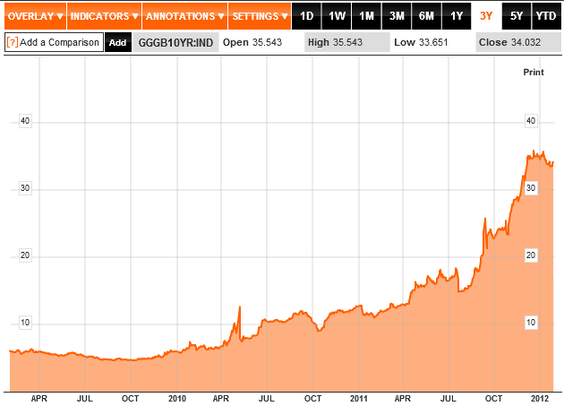
10 Yr. Greek Government Bonds
Source: Bloomberg.com, GGGB2YR:IND, January 31, 2012

Slide 2
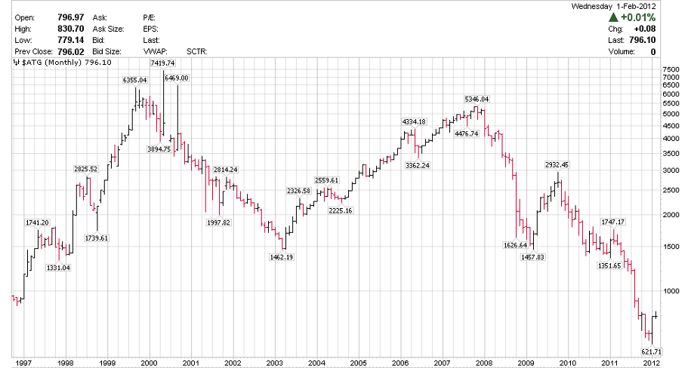
Greek Stock Market
77%
Source: Stockcharts.com, February 01, 2012

Slide 3
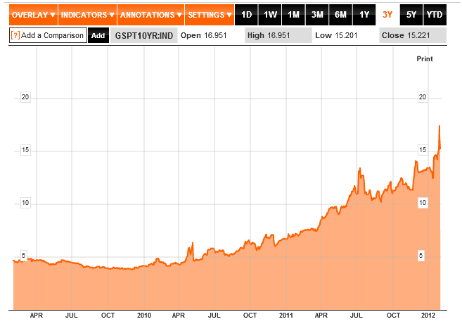
10 Yr. Portugal Government Bonds
Source: Bloomberg.com, GSPT2YR:IND, February 2, 2012

Slide 4
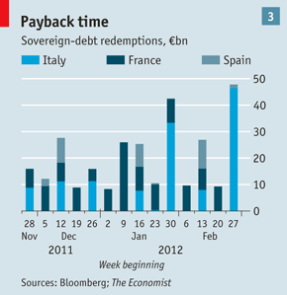
European Debt Maturities In Early 2012
Source: The Economist, November 26, 2011

Slide 5
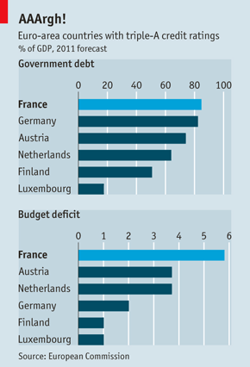
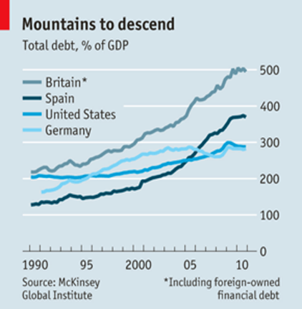
Gov’t Debt/GDP – Deficit % GDP
Source: The Economist, July 9, 2011
Source: The Economist, August 20, 2011

Slide 6
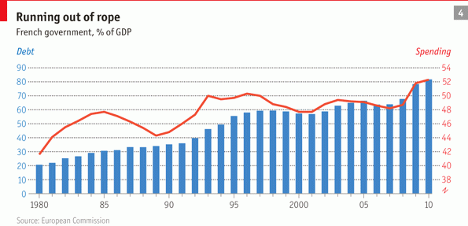
French Government Spending
Source: The Economist, November 12, 2011

Slide 7
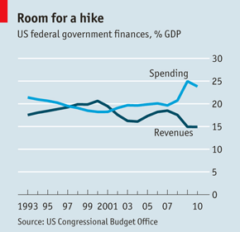
U.S. Government Fiscal Picture
Source: The Economist, July 9, 2011

Slide 8
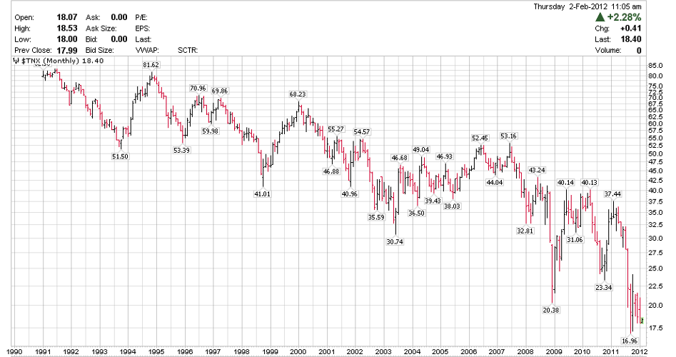
U.S. 10 Yr. Treasury Note Yield
Source: Stockcharts.com, February 2, 2012

Slide 9
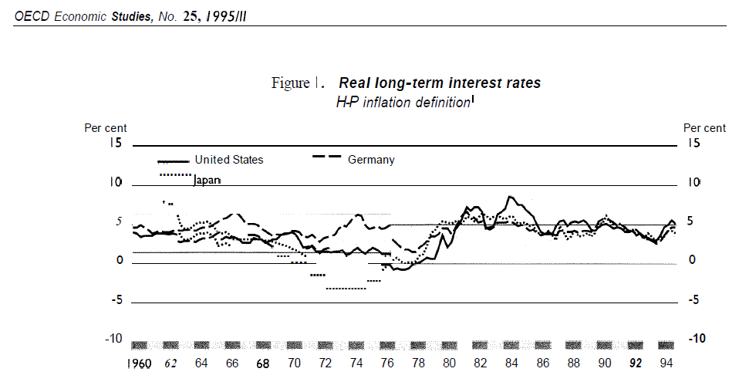
Real Long-Term Interest Rates
Source: OECD Economic Studies No. 25, 1995111

Slide 10
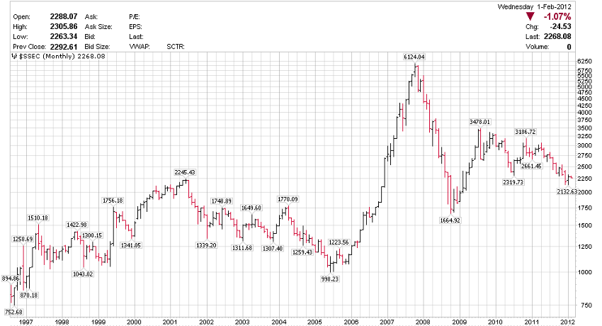
Shanghai Stock Market
? Target
Source: Stockcharts.com, February 1, 2012

Slide 11
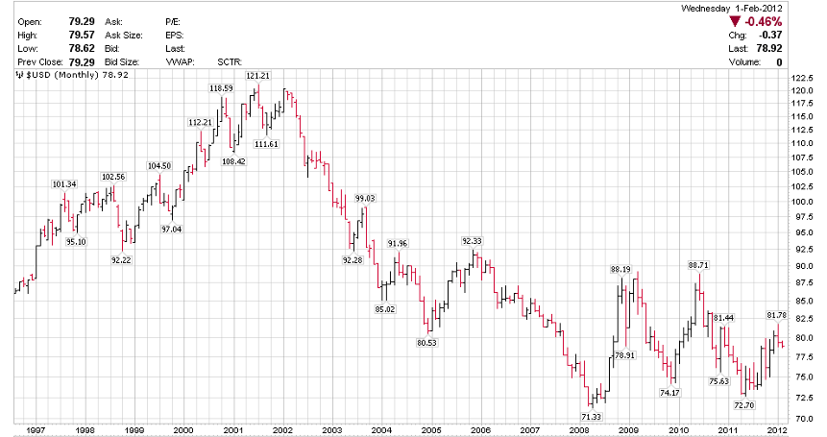
U.S. Dollar
Target 2
Target 1
Source: Stockcharts.com, February 1, 2012

Slide 12
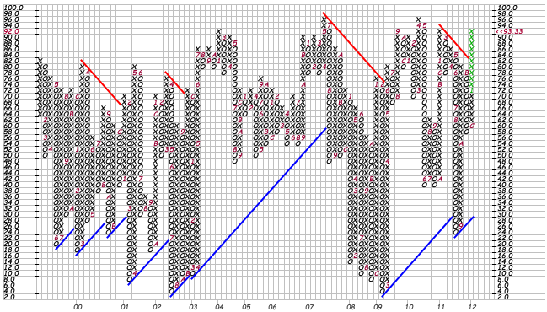
DJI Bullish Percent Index
Market Expensive SELL
Market Cheap BUY
Source: Stockcharts.com, January 27, 2012

Slide 13
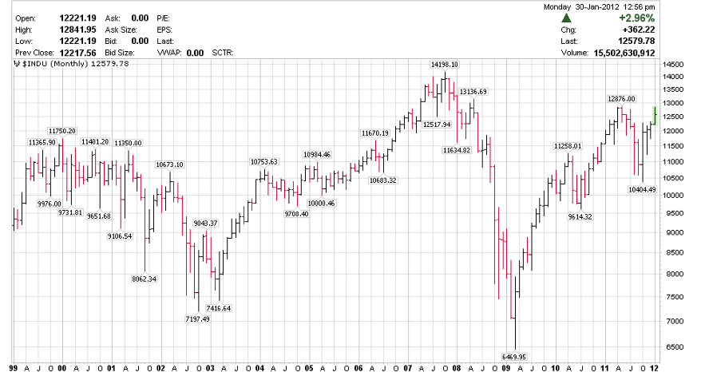
Dow Jones Industrial Index
98% Bulls
93% Bulls
80% Bulls
Q1/12 Target
4% Bulls
2012
Target Low
4% Bulls
Source: Stockcharts.com, January 30, 2012

Slide 14
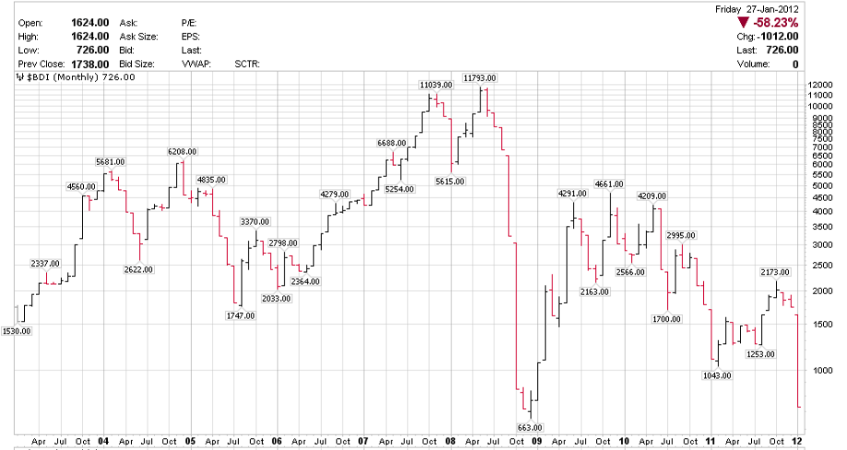
Baltic Freight Rates
DOW Top
BDI
BDI Top
BDI Top
DOW Top
DOW Bottom
BDI Breakdown
BDI Bottom
Source: Stockcharts.com, January 27, 2012

Slide 15
Fearless Forecasts For 2012 - Global
Rollercoaster market year for bonds, stocks & commodities
A number of European countries will default / restructure their debt (Greece leads, followed by Hungary, Portugal, Austria etc.)
US Dollar will surprise to the upside (Debt Ceiling, Obstructionist Republican House

Slide 16
Factors Effecting Oil Prices
High U.S. Inventories – Risk of recession remains
Financial Crisis in Europe – Economies heading into recession lowers energy demand
Excess OECD Inventories
Excess OPEC Supplies
New Supplies from Iraq (3Mb/d – Current potential 5-6Mb/d by 2015-2018) Libya production is growing now 1.3Mb/d expect 1.6Mb/d in 2012 and 3.0Mb/d in 2015
Moderate economic growth
Iran Sabre – Rattling Straits of Hormuz

Slide 17
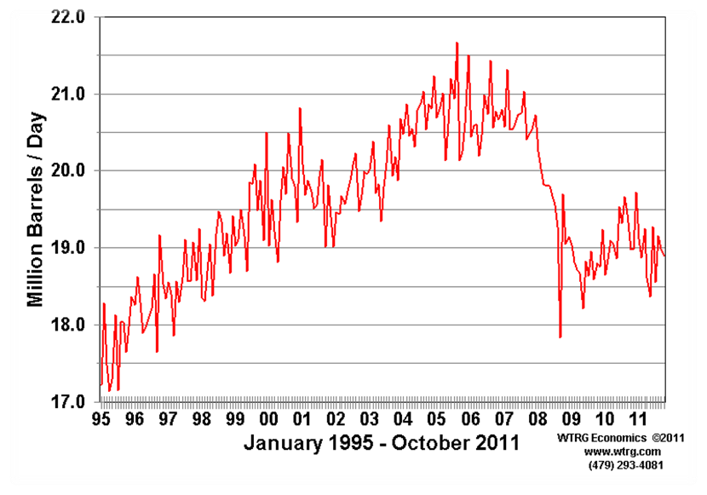
Petroleum Consumption United States
21.8
17.6 Mb/d week ending Jan 27/12
●
Source: WTRG Economics, January, 2012

Slide 18
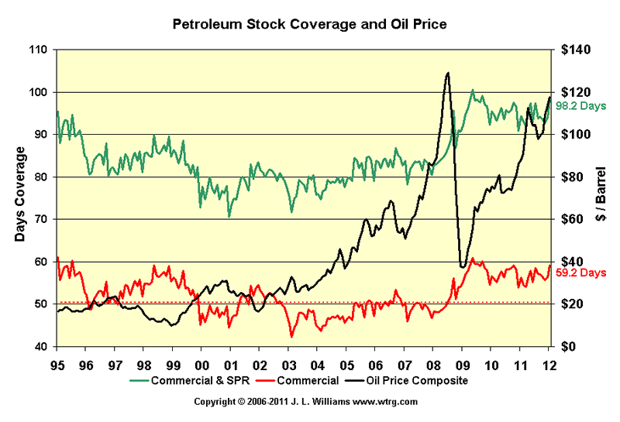
Petroleum Stock Coverage and Oil Price
99.2 Days
59.8 Days
Source: WTRG Economics, January, 2012

Slide 19
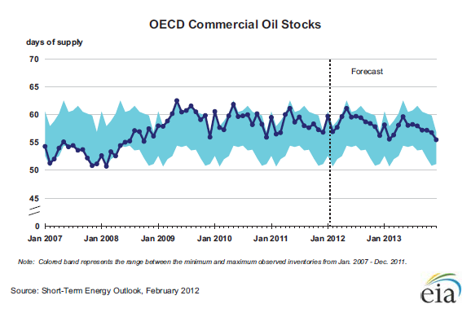
OECD Commercial Oil Stocks
59 days
52 days
Normal End of Winter

Slide 20
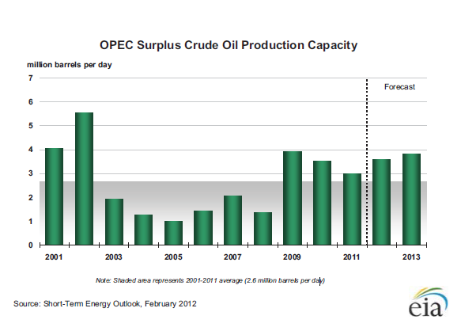
OPEC Surplus Crude Oil Production Capacity

Slide 21
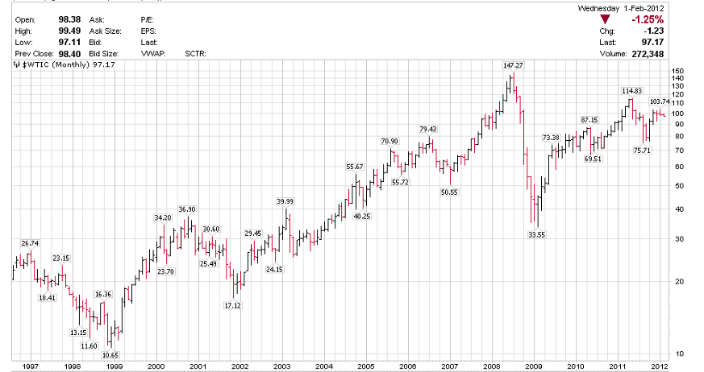
WTI Oil Price Forecast
T1 Expected
Market Panic Case
Source: Stockcharts.com, February 1, 2012

Slide 22
Factors Effecting Natural Gas Prices
Rising demand for natural gas (Electrical, Commercial & Industrial use)
Lucrative hedge books running off -- $9-10/mcf 2009
-- $5-6/mcf 2010-2012
Producers beginning to shut in high cost natural gas production (Chesapeake leads U.S. producers)
Very high storage
Low demand this winter
Large gas additions from liquids rich shale wells.

Slide 23
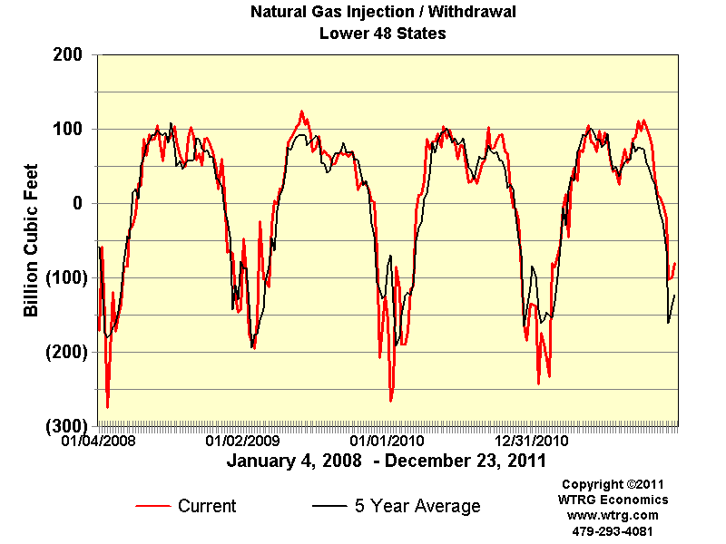
Natural Gas Injection/Withdrawal Lower 48 States
Source: Energy Economist, January 10, 2012

Slide 24
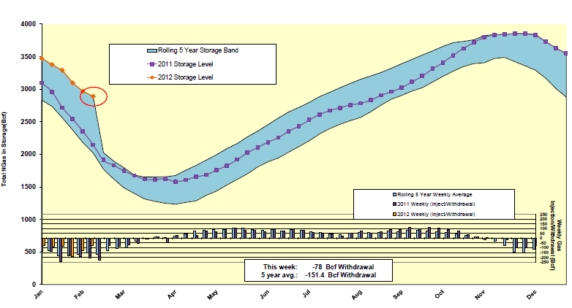
Natural Gas Injections
5 Weeks Left
Source: Stockcharts.com, February 09, 2012

Slide 25
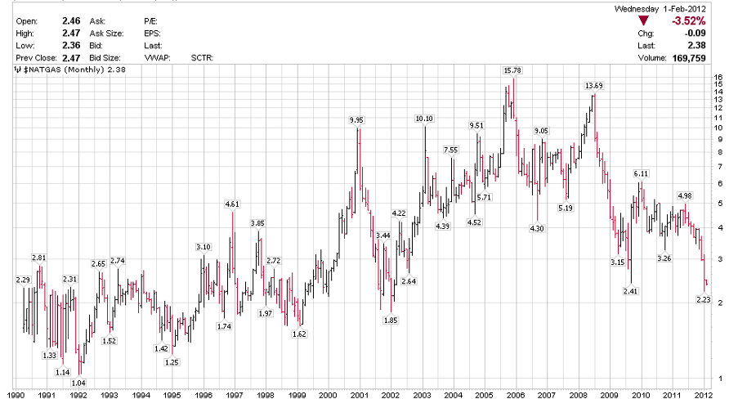
NYMEX US$/MCF
?
Source: Stockcharts.com, February 1, 2012

Slide 26
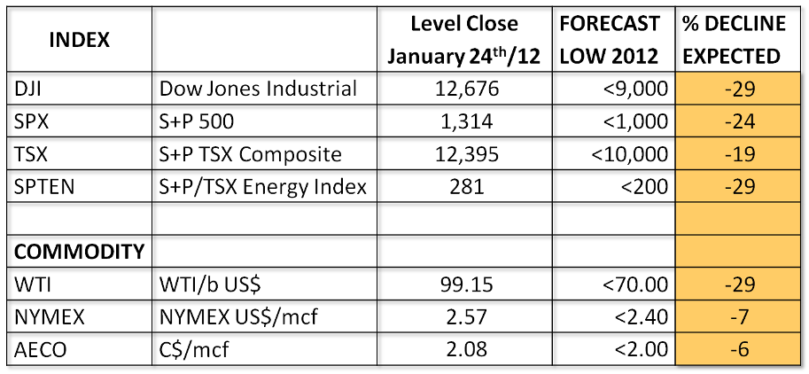
SAMI 2012 Fearless Forecasts
Source: SAMI Maison Energy Monthly, January 26, 2012

Slide 27
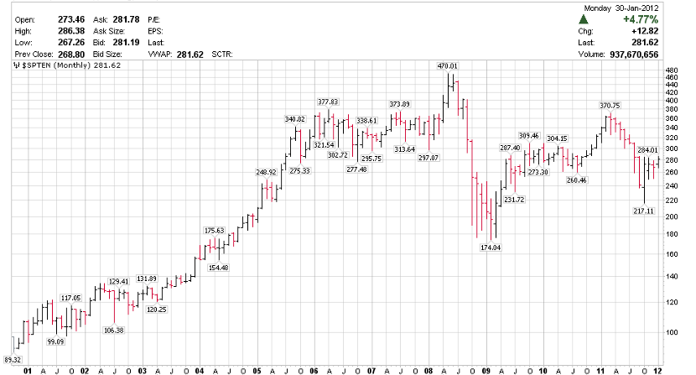
S&P / TSX Energy Index Forecast
Target 1
Target 2 Worst Case
Source: Stockcharts.com, January 30, 2012

Slide 28
Fearless Investment Forecasts For 2012
Hold Significant Cash Reserves For Purchase Opportunities Once Panic / Climactic Market Occurs : Cash Has Optionality
For Aggressive Investors BUY Bearish ETF’s now.
Lock In Cheap Negative Interest Rates (Mortgages For Individuals And Real Estate Investors And Corporate Long Term Bonds For Corporations)
When Fear Returns To Stock Market BUY Commodities – Gold, Oil etc. Watch for <10% Bulls
DJI Bullish % Index
S&P Energy Sector Bullish % Index
Gold Mines Bullish % Index
Buy Energy Explorers with High Impact Potential On Weakness
Our Favourites
Domestic International
Delphi Energy (DEE) Gran Tierra Energy (GTE)
Guide Exploration (GO) Niko Resources (NKO)
Vero Energy (VRO) Sterling Resources (SLG)
WesternZagros (WZR)

