Slide 1
Timing the Market using Technical, Fundamental and Seasonality Analysis
Presented to
World Outlook Financial Conference
February 10th and 11th , 2012
by
Don Vialoux, CMT
www.timingthemarket.ca
www.equityclock.com

Slide 2
A Growing Interest in Seasonality Investing
Growth in interest in www.timingthemarket.ca
Growth in interest in www.equityclock.com
Horizons Seasonal Rotation Fund (HAC)

Slide 3
The Seasonality Process
Seasonality: Find periods of seasonal strength or weakness
See www.equityclock.com and Thackray’s 2012 Investor Guide
Fundamentals: Determine the annual recurring events that trigger seasonality
Are recurring events happening this year?
Technical analysis: Fine tune entry and exit points

Slide 4
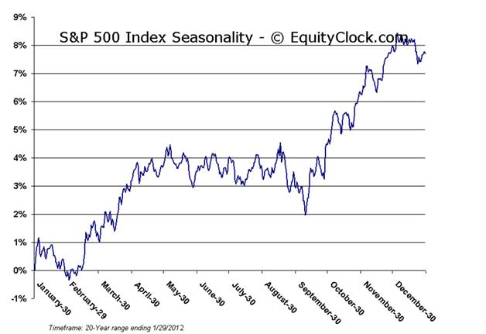

Slide 5
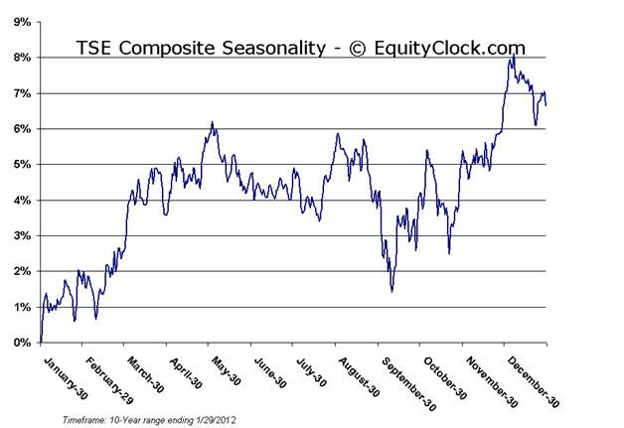

Slide 6
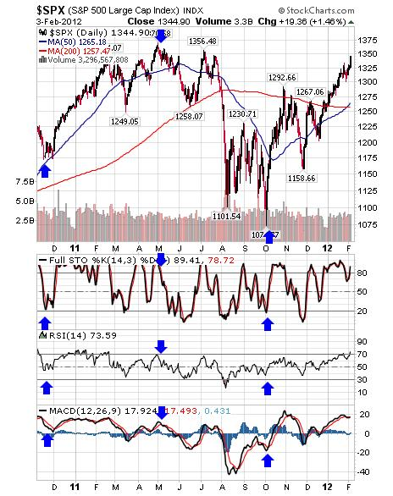

Slide 7
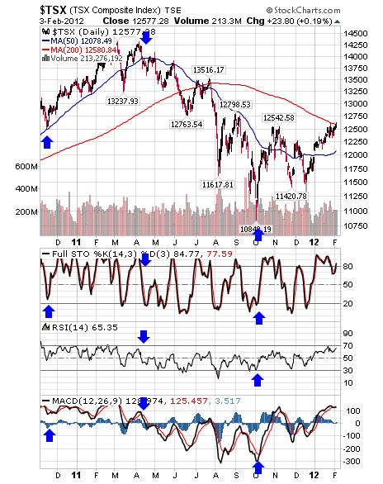

Slide 8
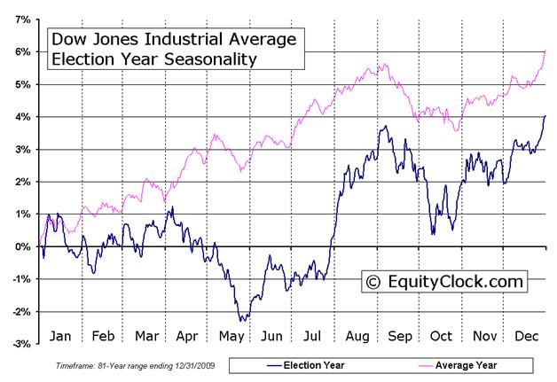

Slide 9
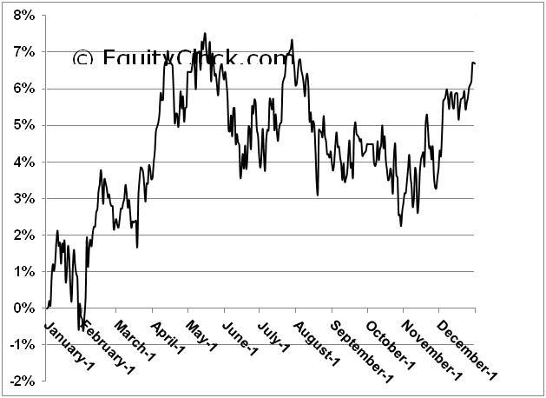
10 Year seasonality chart on the Shanghai Composite Index

Slide 10
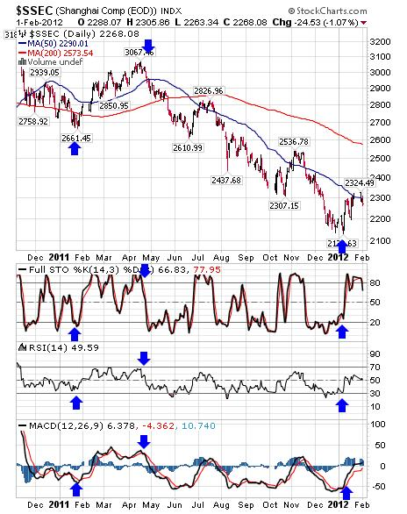

Slide 11
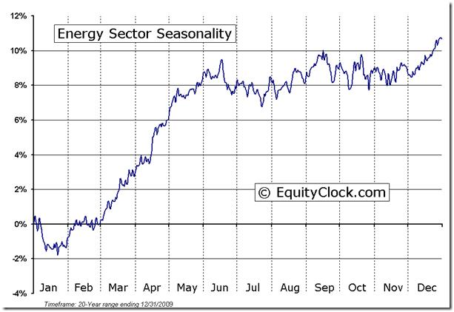

Slide 12
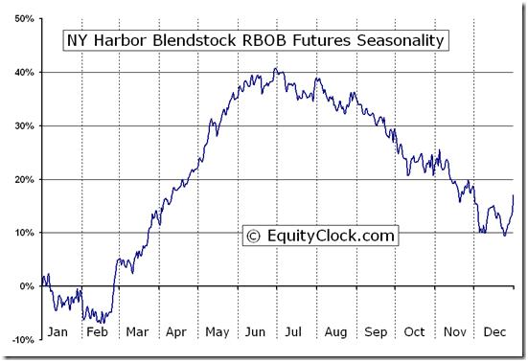

Slide 13
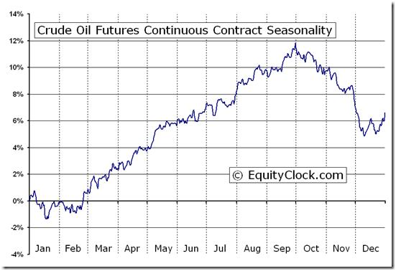

Slide 14
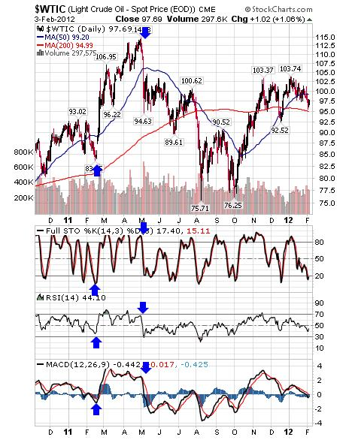

Slide 15
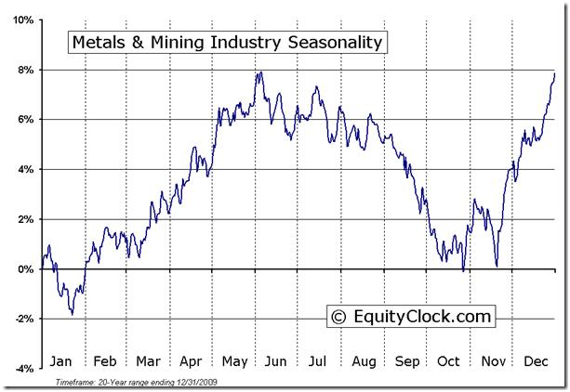

Slide 16
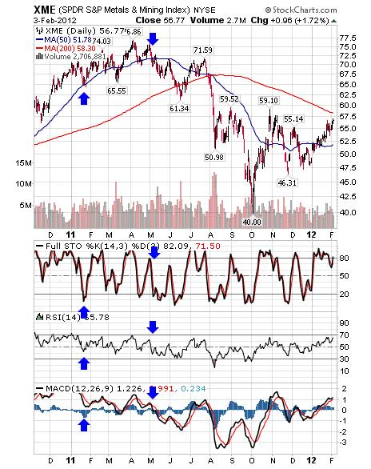

Slide 17
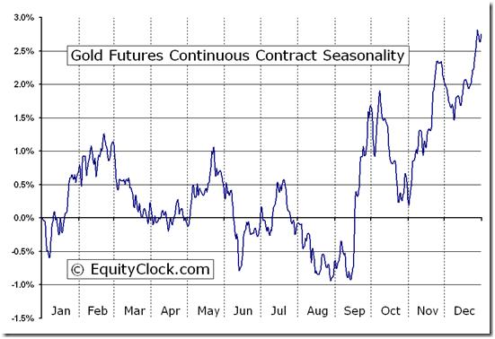
Gold or . . .

Slide 18
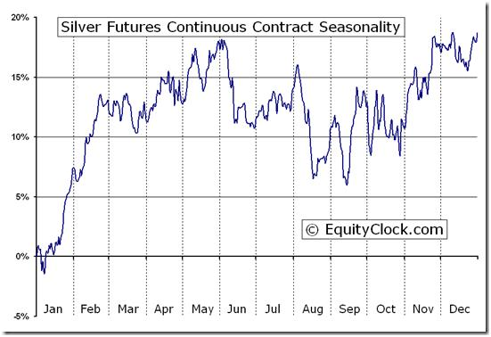

Slide 19
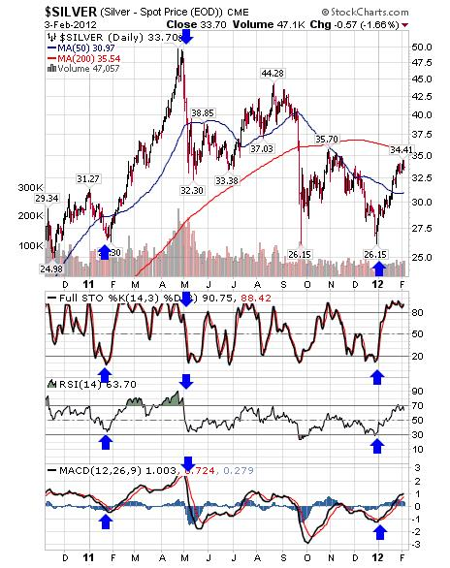

Slide 20
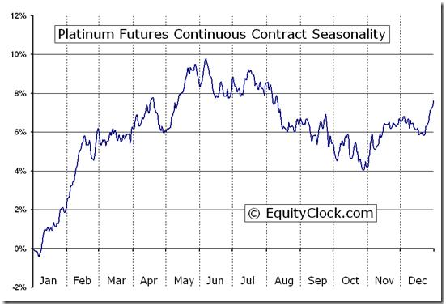
Platinum Futures (PL) Seasonal Chart

Slide 21
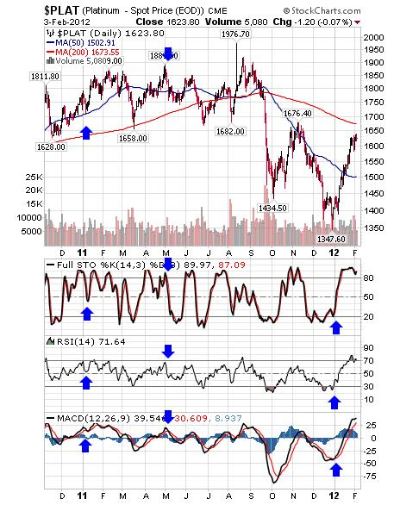

Slide 22
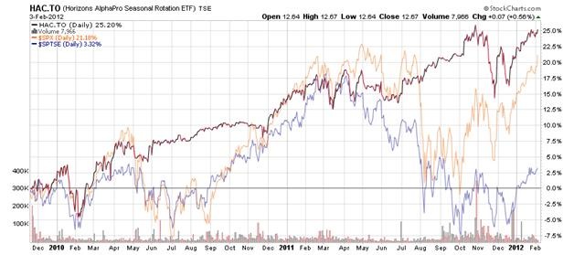

Slide 23
Questions
?
Disclaimer: Comments and opinions offered in this presentation are for information only. They should not be considered as advice to purchase or to sell mentioned securities. They should not be considered as recommendations made by Mr. Vialoux.

Slide 24
Contacts
Don Vialoux
www.dvtechtalk.com
www.timingthemarket.ca
www.equityclock.com

